Slide 1
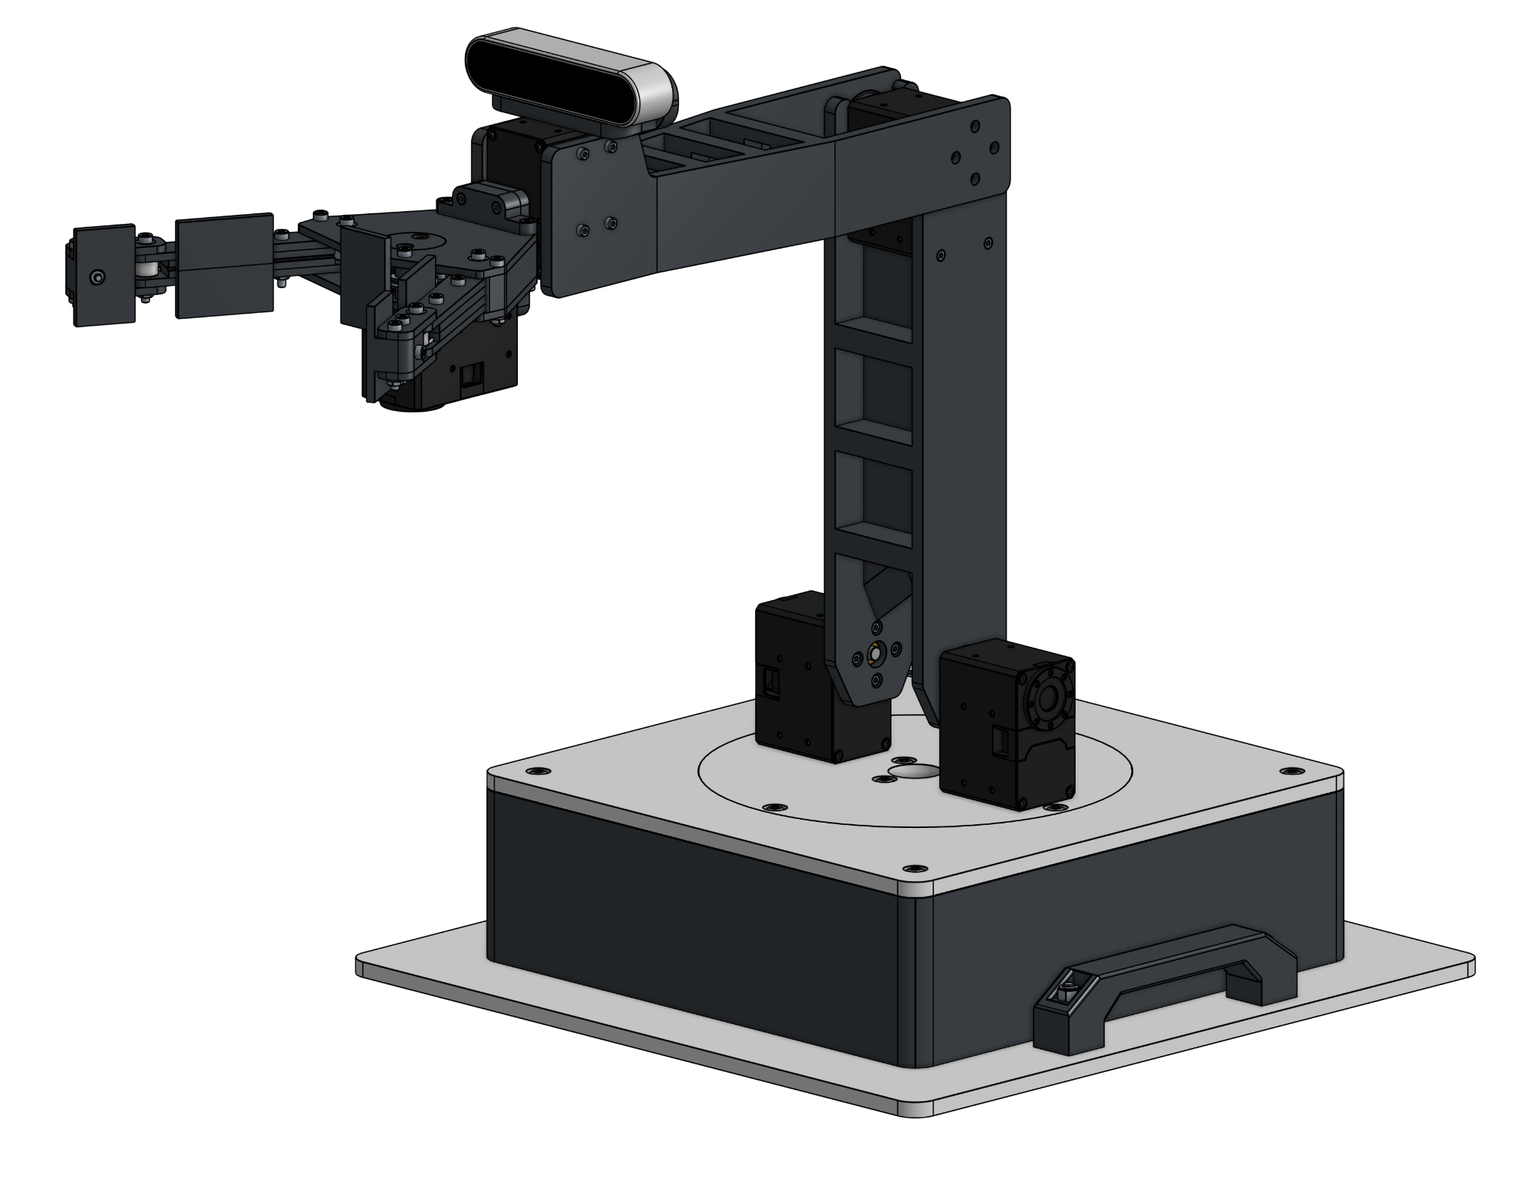
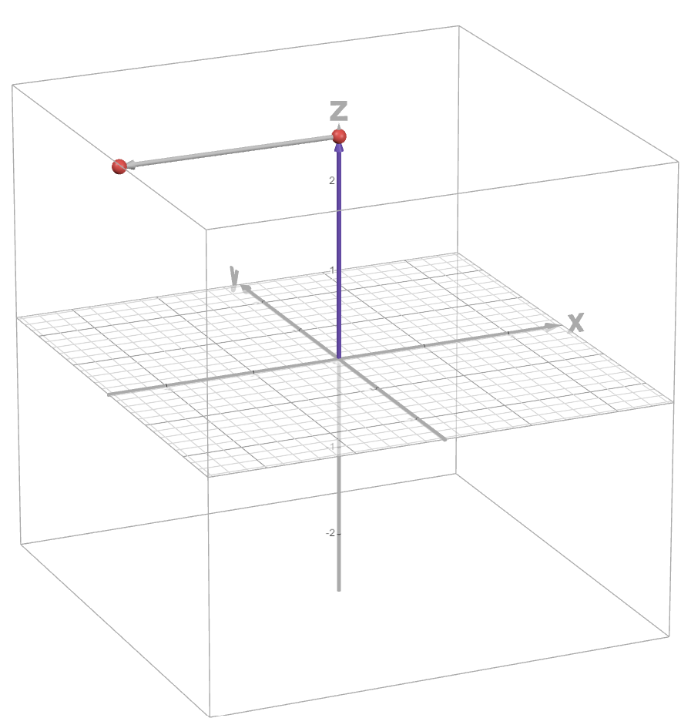
The Trigonometric Approach to Forward Kinematics
By Joseph Ruhan

Slide 2
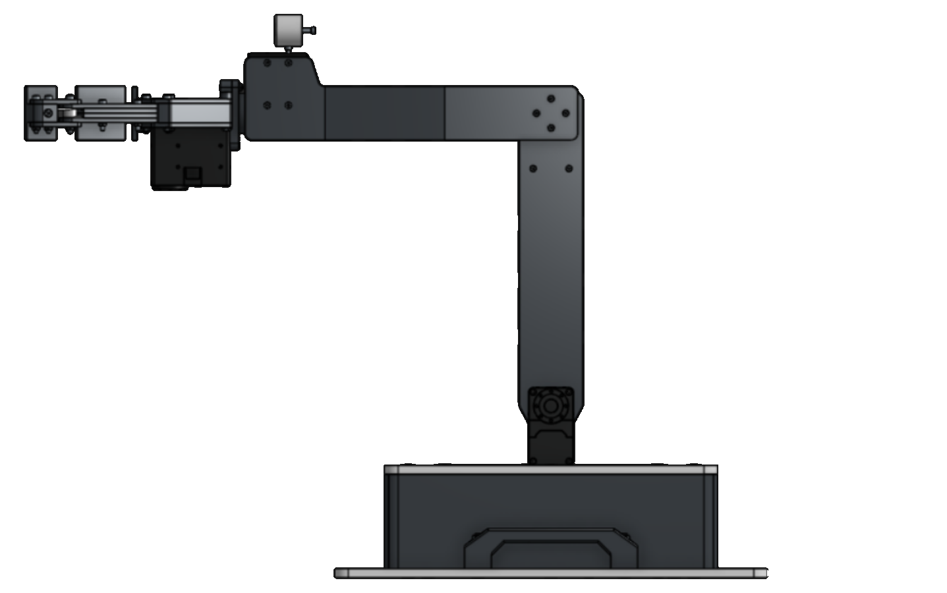
Forward
L₂
Where
L₁=250mm
L₂=250mm
These are always known because they are a constant
L₁

Slide 3
The arm can be described mathematically by defining its joints and links
L₂
Where
L₁=250mm
L₂=250mm
These are always known because they are a constant
L₁

Slide 4
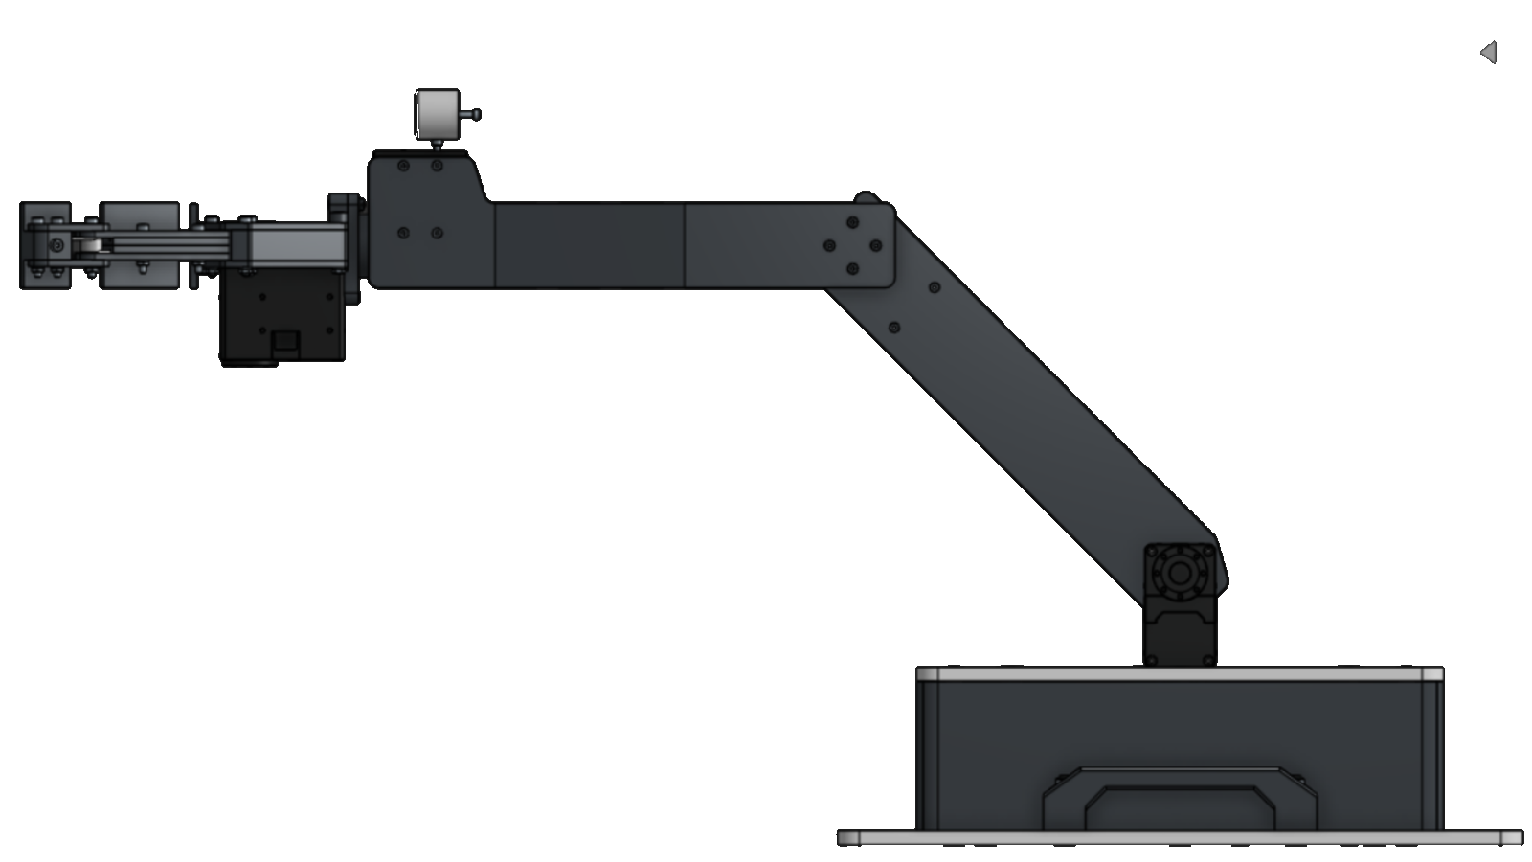
The arm can be described mathematically by defining its joints and links
In this example
θ₁=45°
θ₂=45°
θ₁ is measured relative to a vertical projection above the shoulder motors
θ₁ is measured relative to a vertical projection from the upper arm segment
θ₂
θ₁
These angles are variable.
However, because the encoder measures the rotation of the actuator, the angles are always known

Slide 5
The arm can therefore be represented as such:
= a joint
L₁=250mm
L₂=250mm
θ₁=45°
θ₂=45°
θ₂
L₂
θ₁
L₁

Slide 6
The arm can therefore be represented as such:
= a joint
L₁=250mm
L₂=250mm
θ₁=45°
θ₂=45°
(X, Y)
θ₂
Y
θ₁
The location of the end effector is the unknown variable
(0, 0)
X

Slide 7
The arm can therefore be represented as such:
= a joint
ΔX₁
L₁=250mm
L₂=250mm
θ₁=45°
θ₂=45°
(X, Y)
θ₂
ΔX₂
ΔY₁
θ₁
The position of the end effector will be a sum of the vertical and horizontal displacement of each joint

Slide 8
The arm can therefore be represented as such:
= a joint
L₁=250mm
L₂=250mm
θ₁=45°
θ₂=45°
θ₂
ΔX₁
(X, Y)
ΔX₂
ΔY₁
The displacement can be represented by triangles
θ₁
(0, 0)

Slide 9
To calculate the position of the end point:
L₁=250mm
L₂=250mm
θ₁=45°
θ₂=45°
In this example, L₁ is
the hypotenuse of a
triangle.
Using sin(θ₁):
sin(θ₁) = ΔX₁/L₁
L₁sin(θ₁) = ΔX₁
250*(√2/2) = ΔX₁
ΔX₁ = 176.777mm
θ₂
ΔX₁
(X, Y)
ΔX₂
ΔY₁
L₁
θ₁
(0, 0)

Slide 10
To calculate the position of the end point:
ΔX₁ = 176.777mm
For cos(θ₁):
cos(θ₁) = ΔY₁/L₁
L₁sin(θ₁) = ΔY₁
250*(√2/2) = ΔY₁
ΔY₁ = 176.777mm
And cos(θ₂):
cos(θ₂) = ΔX₂/L₂
L₂cos(θ₁) = ΔX₂
250*(1) = ΔX₂
ΔX₂ = 250mm
And sin(θ₂):
cos(θ₂) = ΔY₂/L₂
L₂cos(θ₁) = ΔY₂
250*(0) = ΔY₂
ΔY₂ = 0mm
θ₂
ΔX₁
(X, Y)
ΔX₂
ΔY₁
θ₁
(0, 0)

Slide 11
To calculate the position of the end point:
ΔX₁ = 176.777mm
ΔY₁ = 176.777mm
ΔX₂ = 250mm
ΔY₂ = 0mm
θ₂
ΔX₁
(X, Y)
ΔX₂
(X,Y) = (ΔX₁+ΔX₂,ΔY₁+ ΔY₂)
(X,Y) = (426.777, 176.777)
ΔY₁
θ₁
(0, 0)

Slide 12
Completed Variables
θ₂
θ₁
(426.777, 176.777)
L₁=250mm
L₂=250mm
θ₁=45°
θ₂=45°
(X,Y) = (426.777, 176.777)

Slide 13
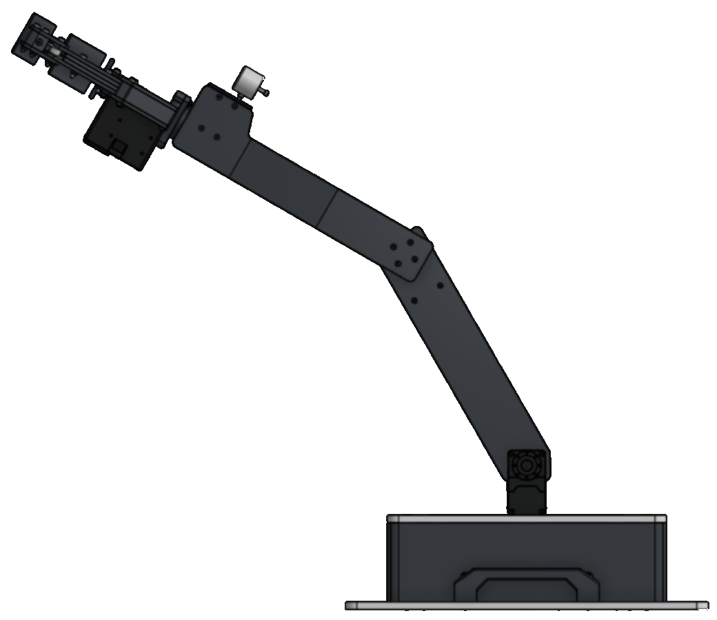
Try It Yourself:
L₁=250mm
L₂=250mm
θ₁=30°
θ₂=30°
(X,Y) = (?,?)
θ₂
(X,Y)
θ₁

Slide 14
Try It Yourself:
L₁=250mm
L₂=250mm
θ₁=30°
θ₂=30°
(X,Y) = (?,?)
θ₂
(X,Y)
Solution:
(X,Y) = (341.506, 341.506)
θ₁
Click To Reveal

Slide 15
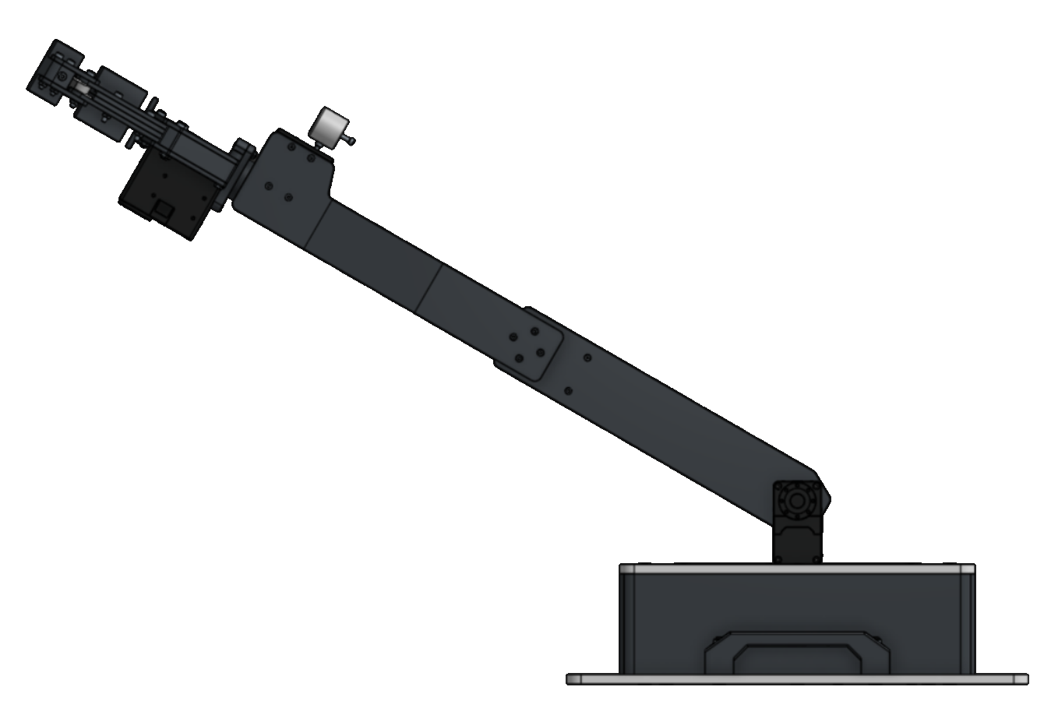
Try It Yourself 2:
L₁=250mm
L₂=250mm
θ₁=60°
θ₂=0°
(X,Y) = (?,?)
(X,Y)
θ₁

Slide 16
Try It Yourself 2:
L₁=250mm
L₂=250mm
θ₁=60°
θ₂=0°
(X,Y) = (?,?)
(X,Y)
Solution:
(X,Y) = (433.013, 250)
θ₁
Click To Reveal

Slide 17
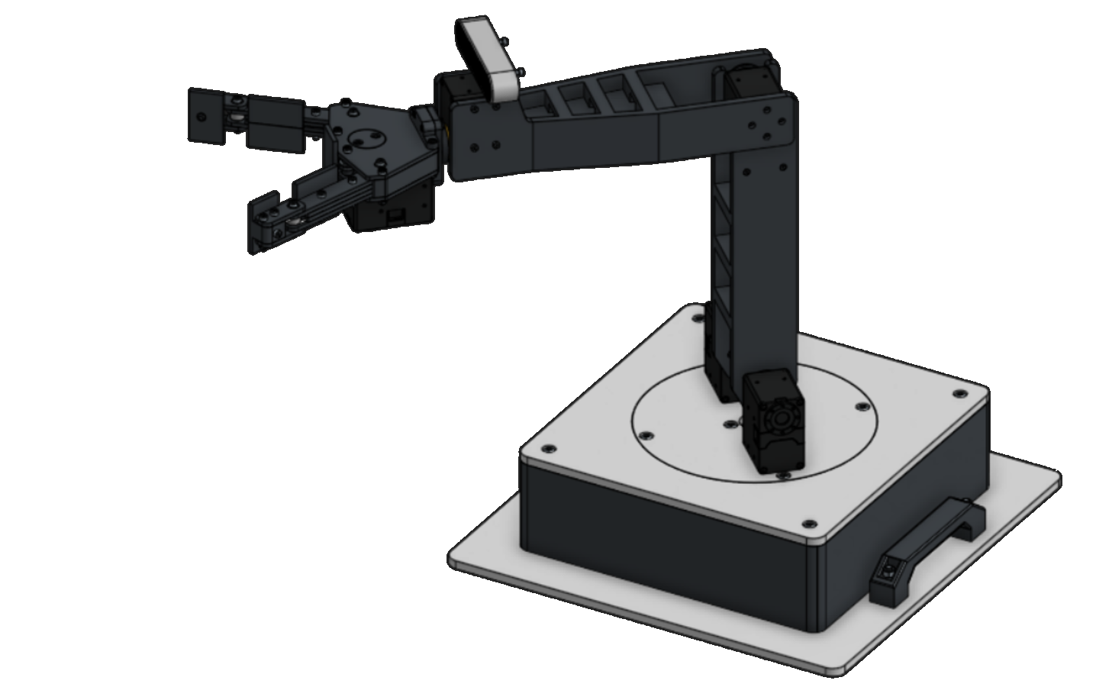
Forward Kinematics With Base Rotation

Slide 18
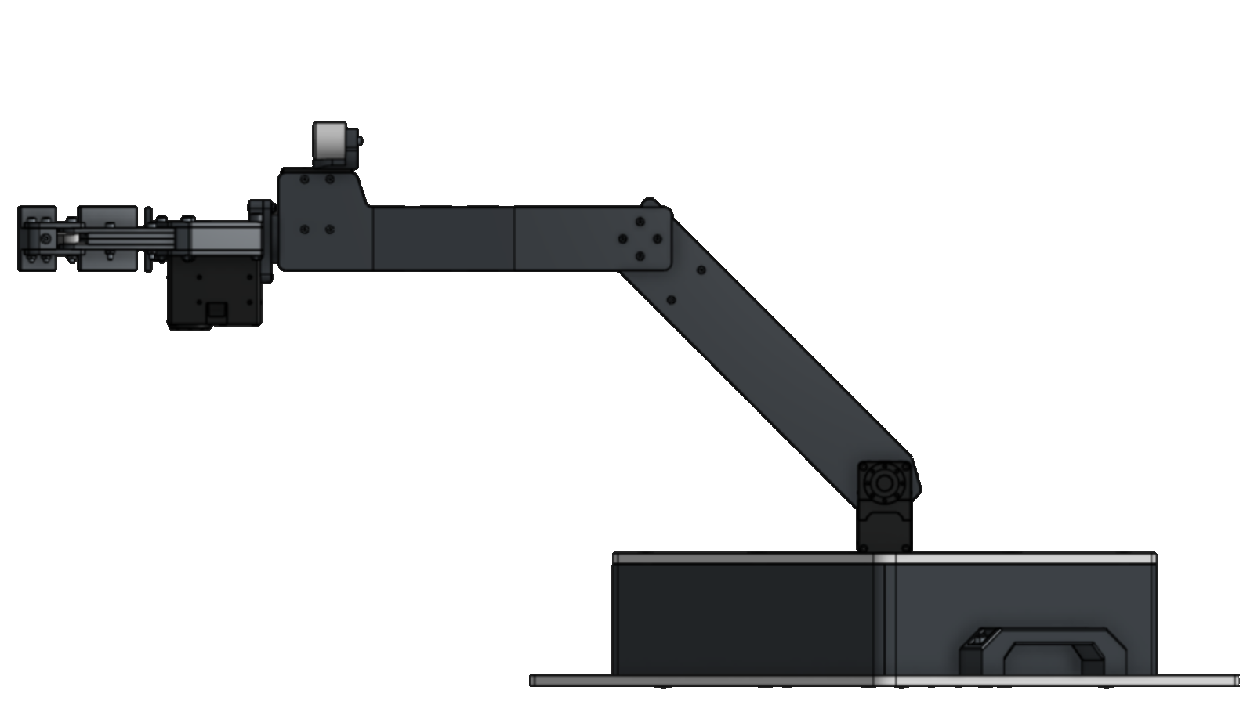
The arm’s forward kinematics with base rotation is dependent on rotation around the center point of the base
(X,Y)
R
Where
R = Horizontal distance from end effector to base center point

Slide 19
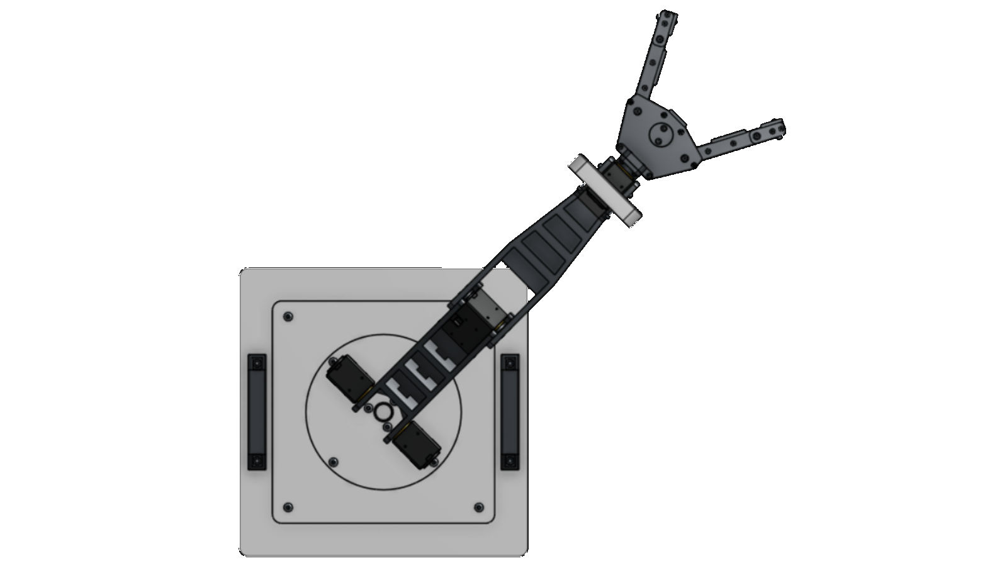
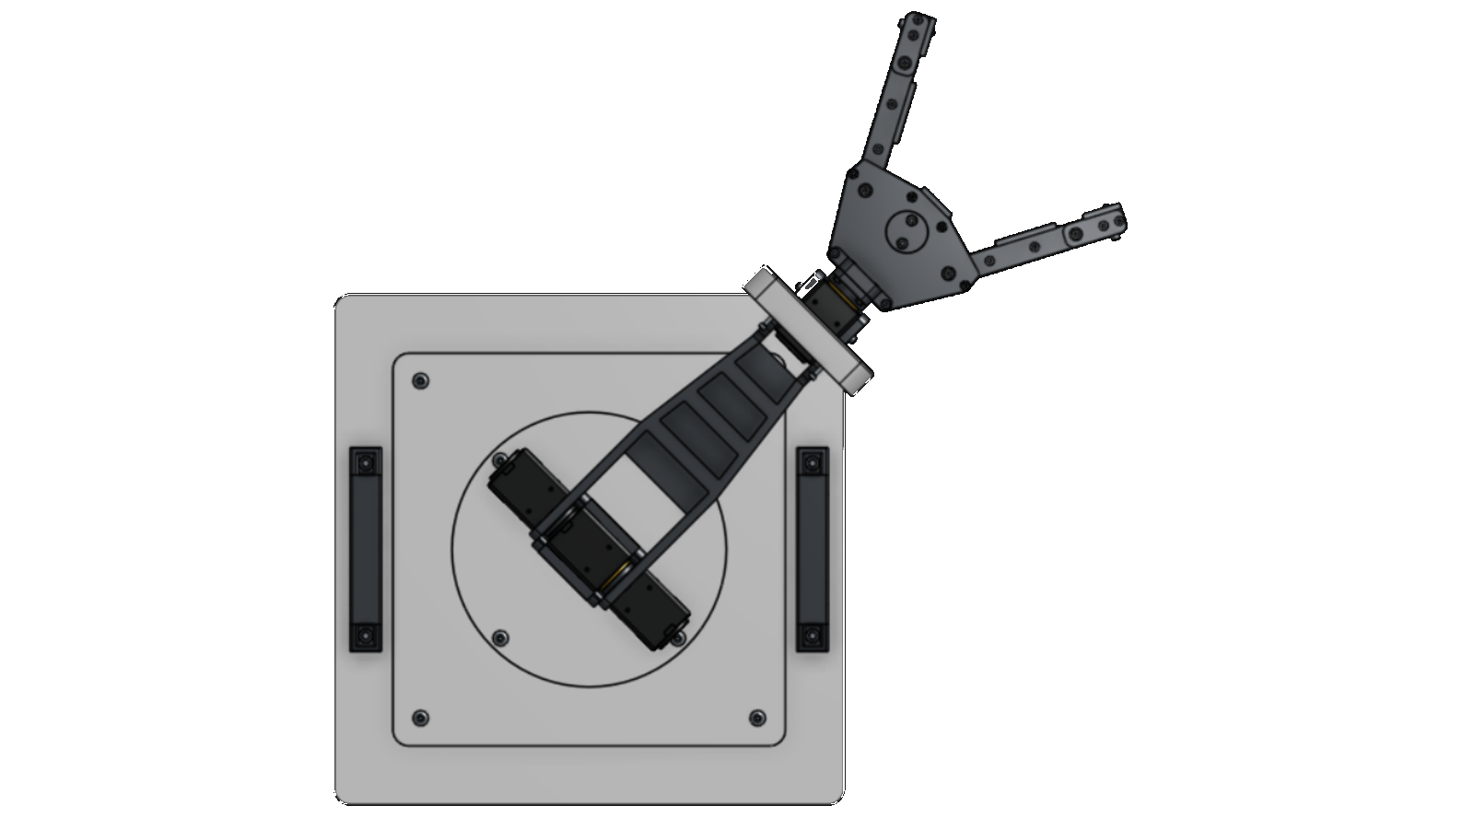
R is variable because the end effector can move away or closer to the base center point, horizontally
R₂
R₁
R₁ < R₂

Slide 20
R forms a circle around the center of the base when rotated
R

Slide 21
θ₃ is known because we can measure the rotation of the base actuator with its encoder
θ₃
R

Slide 22
So if R is calculated, the position of the end effector in 3D space can be determined
(X,Z)
X
θ₃
R
Z

Slide 23
The problem can be represented as a circle with a radius
To find (X,Z)
1. Find R
2. Calculate the
location of R on the
circle
(X,Z)
X
θ₃
R
Z

Slide 24
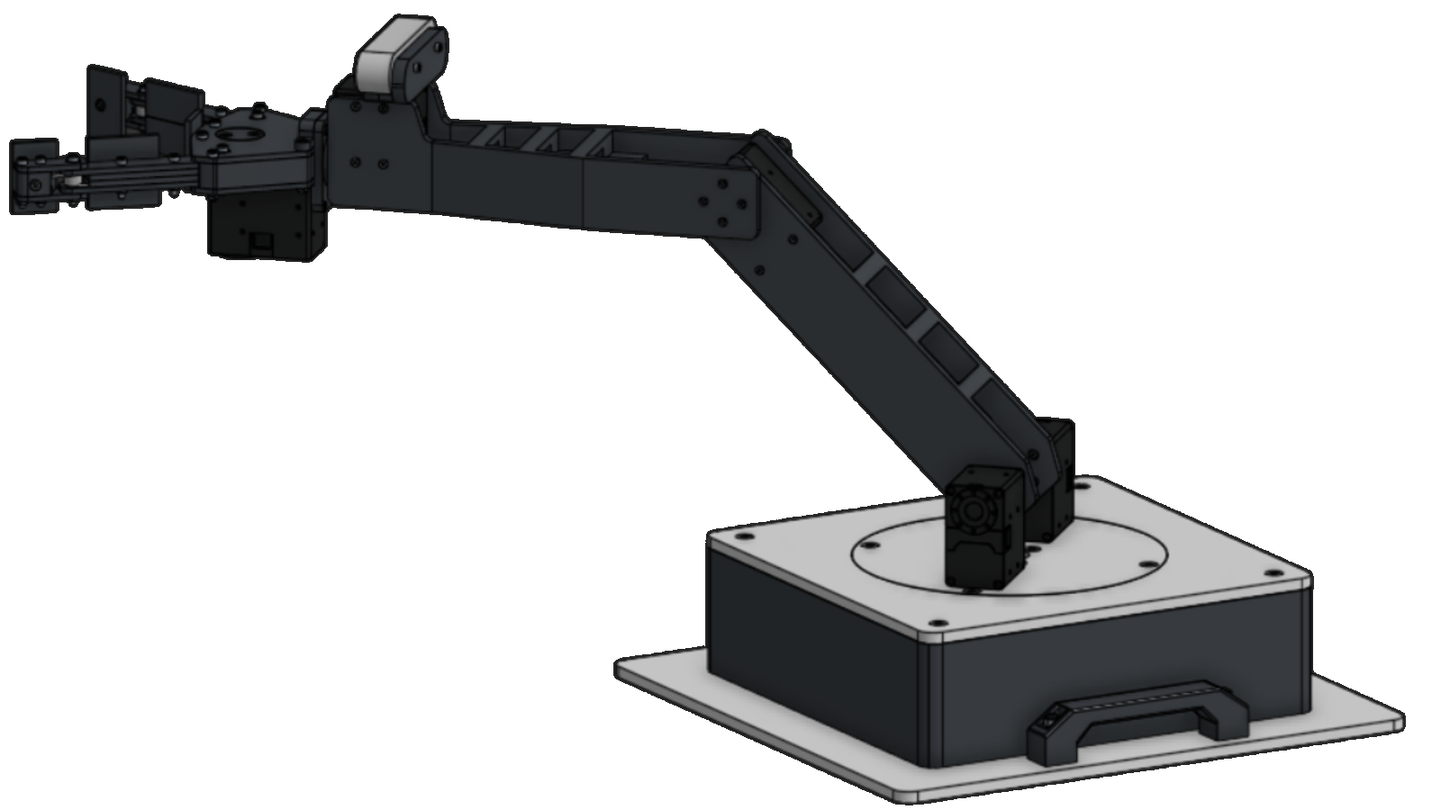
Example Problem
Y
Z
L₁=250mm
L₂=250mm
θ₁=45°
θ₂=45°
θ₃=45°
(X,Y,Z) = (?,?,?)
θ₃
X

Slide 25
This problem can be split into two 2D problems
Solving for R:
along the
XZ Plane
Solving for X and Z:
Along an XY plane relative to the arm

Slide 26
The problem can be solved along these two planes
X
θ₂
θ₃
R
θ₁
Z
R

Slide 27
R will be equal to the X value we calculated when analyzing this position in 2D
(X, Y)
θ₂
For this problem
(L₁=250mm, L₂=250mm, θ₁=45°, θ₂=45°)
We solved it already and
determined (X,Y) to equal
(426.777, 176.777)
In this frame, R=x
Therefore, R=426.77mm
and Y=176.78mm
θ₁
R

Slide 28
Along the XZ Plane
R= 426.77mm
θ₃= 45°
Z = Rsin(θ₃)
X = Rcos(θ₃)
Z = 301.77mm
X = 301.77mm
Z
X
θ₃
R
X
θ₃
R
Z

Slide 29
Example Problem: Solution
L₁=250mm
L₂=250mm
θ₁=45°
θ₂=45°
θ₃=45°
Y
Z
X = 301.77mm
Y=176.78mm
Z = 301.77mm
X

Slide 30
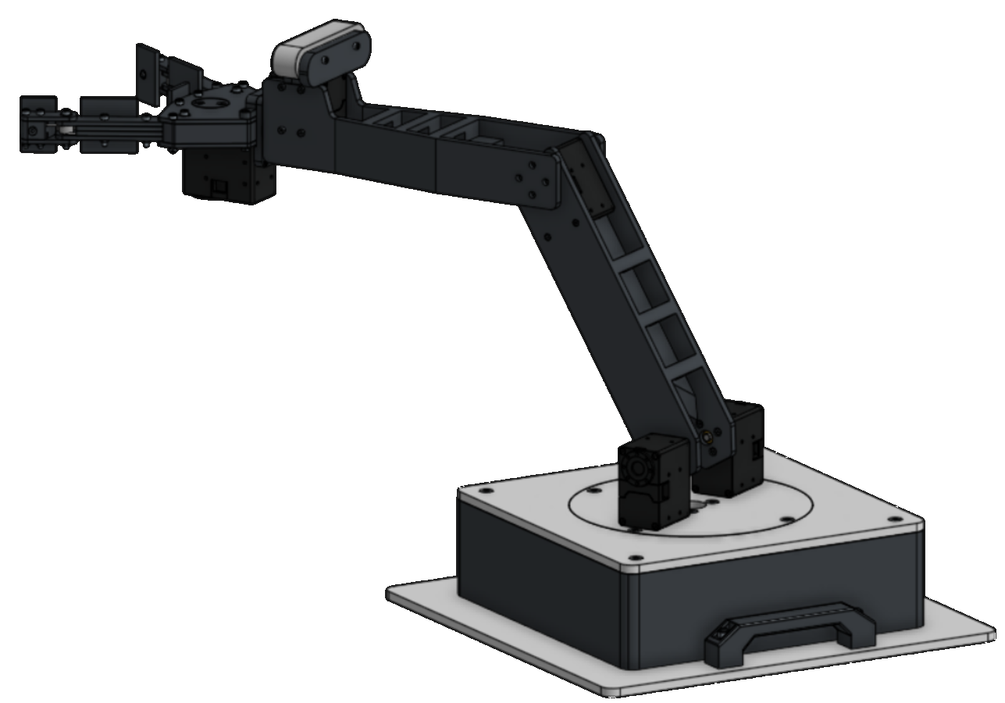
Practice Problem
L₁=250mm
L₂=250mm
θ₁=30°
θ₂=30°
θ₃=60°
(X,Y,Z) = (?,?,?)
Y
Z
θ₃
X

Slide 31
Practice Problem
L₁=250mm
L₂=250mm
θ₁=30°
θ₂=30°
θ₃=60°
(X,Y,Z) = (?,?,?)
Y
Z
Solution:
(X,Y,Z) = (187.5,216.51,324.76)
Click To Reveal
θ₃
X

Slide 32
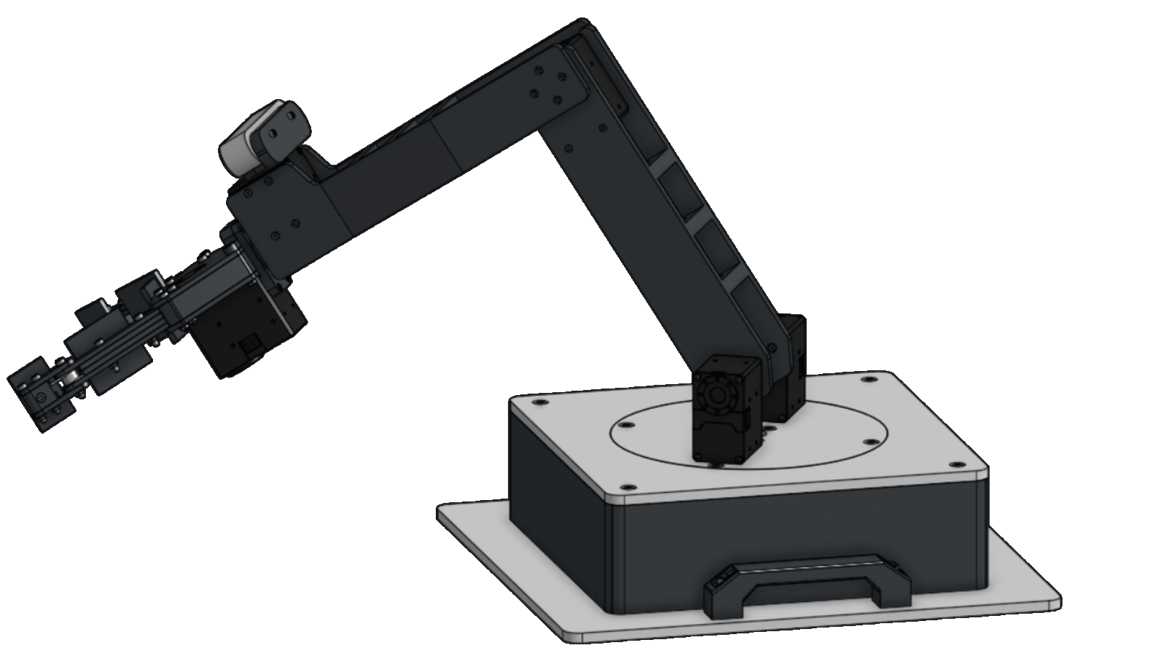
Practice Problem 2
L₁=250mm
L₂=250mm
θ₁=30°
θ₂=90°
θ₃=30°
(X,Y,Z) = (?,?,?)
Y
Z
θ₃
X

Slide 33
Practice Problem 2
L₁=250mm
L₂=250mm
θ₁=30°
θ₂=90°
θ₃=30°
(X,Y,Z) = (?,?,?)
Y
Z
θ₃
Solution:
(X,Y,Z) = (295.75,-170.75,91.51)
X
Click To Reveal

Slide 34
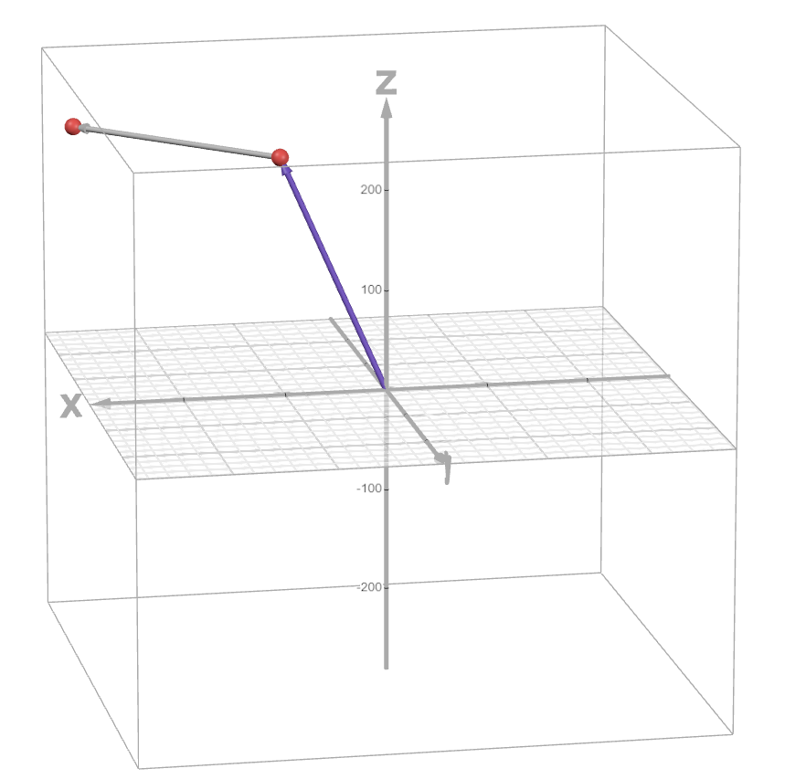
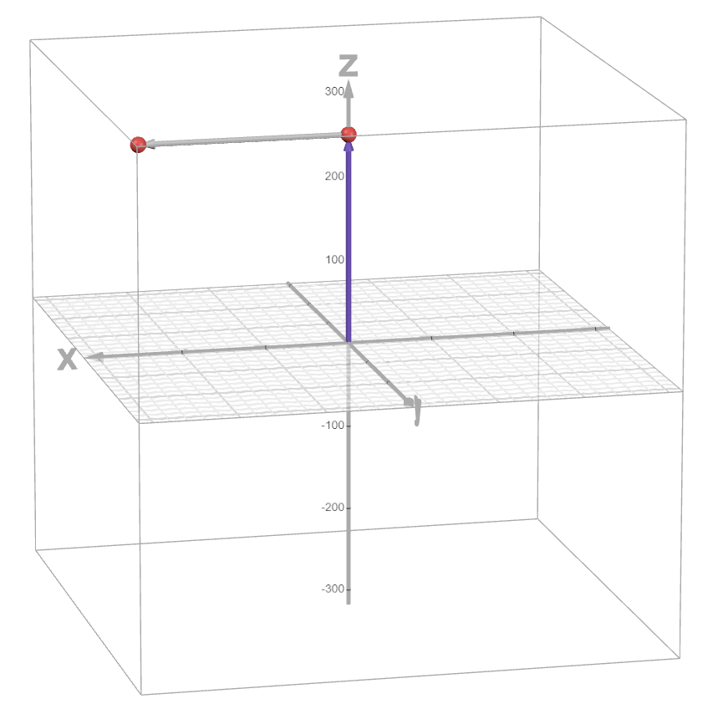
Desmos Calculator
https://www.desmos.com/3d/9bnvqc263x

